Slide 1
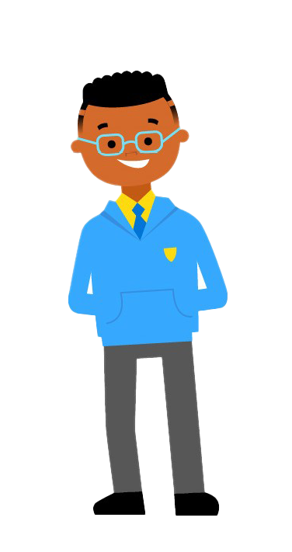
CELCIS Education Forum
26 November 2024

Slide 2
Today's session
Child poverty – current picture
Impact of poverty on learning, participation and wellbeing at school
Poverty stigma for children and families
What children and young people say we need to change
Poverty aware communication and income maximisation
Helpful resources

Slide 3
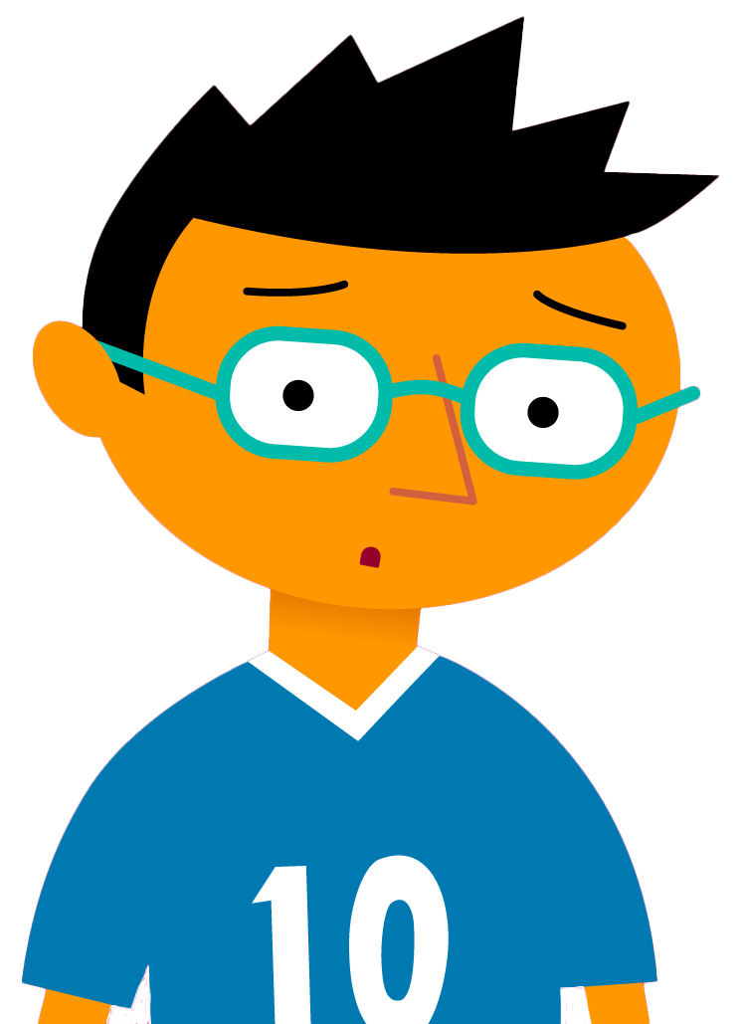
Child poverty
Not having enough resources to meet household needs and participate in society
Almost 1 in 4 children in Scotland are in poverty – 24%, 240,000
70% of children in poverty are in a household where someone works
Rates vary but poverty exists everywhere in Scotland
Rates higher amongst some families – lone parent, larger, disabled, mothers <25, children <1, minority ethnic

Slide 4
What causes child poverty?
Not enough income…
High cost of living
From employment
From social security
'In work poverty'
Low pay
Insecure/ not enough hours
Childcare, travel costs, caring responsibilities…
Couple with 2 children on out of work benefits can only cover 48% of their family costs; lone parent family only 49%
Housing, food, fuel, transport, clothing, school...
‘Cost of living crisis’
More info: Cost of a Child report 2023

Slide 5
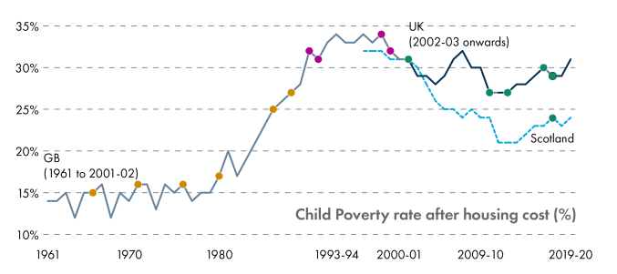
Poverty isn't inevitable
CHILD POVERTY IN SCOTLAND SINCE THE 1960S - SCOTTISH PARLIAMENT INFORMATION CENTRE

Slide 6
Children's rights
My right to education means I should receive an education regardless of my home issues or situation. (Secondary pupil)
Means I am able to learn without any problems. (Primary pupil)
Our right to education means we can take part in all learning like school trips and fun activities. (Primary pupil)
I know that they are trying to make sure everybody in Scotland has children’s rights, but poverty can mean it’s harder.
(Secondary pupil)​

Slide 7
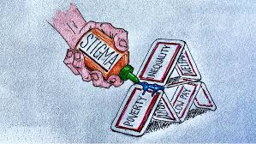
Impact of Stigma
There is still stigma and people get embarrassed; we need to stop that. (Secondary pupil)
It could mean you feel shame and not be able to cope with stuff and could be bullied. (Primary pupil)
I try really hard for it not to show to the other kids that my son is from a low-income family by making sure he takes part and contributes to everything. (Parent)

Slide 8
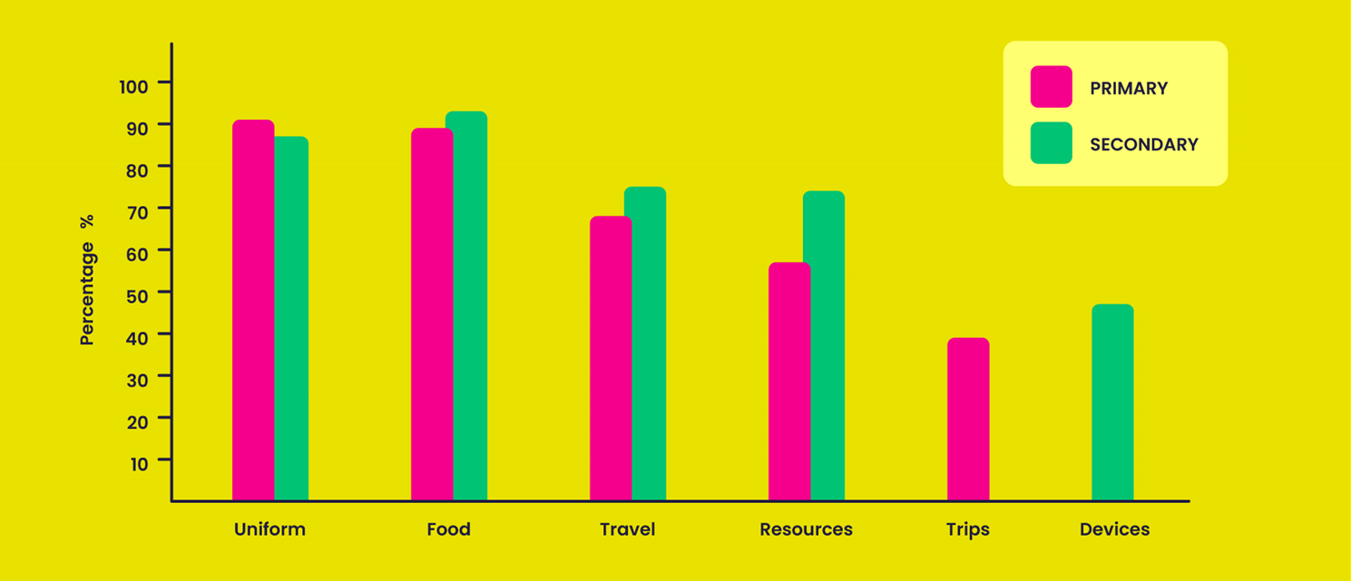
What young people say about problem costs
Cost of the School Day Big Question report and film – views on readiness to learn, top costs, food, and school trips. 5394 children and young people responding across Scotland

Slide 9
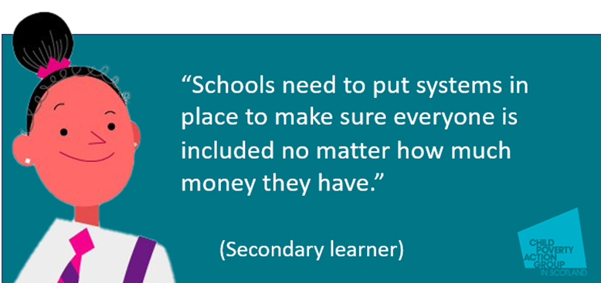
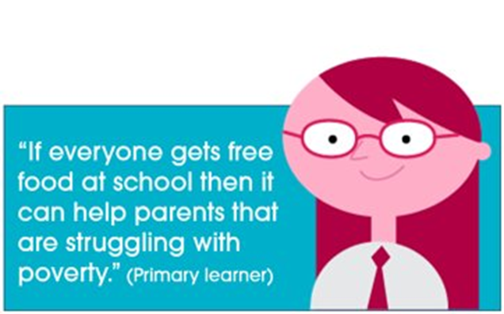
Ready to learn – practical school level actions
Everything we need to learn in the classroom and at home
Food throughout the school day
Help to go on trips
Everybody learn about poverty and equity
Help families claim financial entitlements
Kind adults that listen to us
Safe and quiet spaces in school
Named person families/pupils can go to for help
Tell everyone about support available.

Slide 11
Reducing costs, boosting incomes, supporting families
Reviewing uniform policies
Breakfast clubs and free snacks
Take what you need trollies
Device lending schemes
Supporting families with entitlements
Low cost and free fun events
Donation only charity days
Prom/ Halloween swap shops
Clear yearly cost calendar for families
Free clubs with equipment
PEF subsidising school trip costs

Slide 12
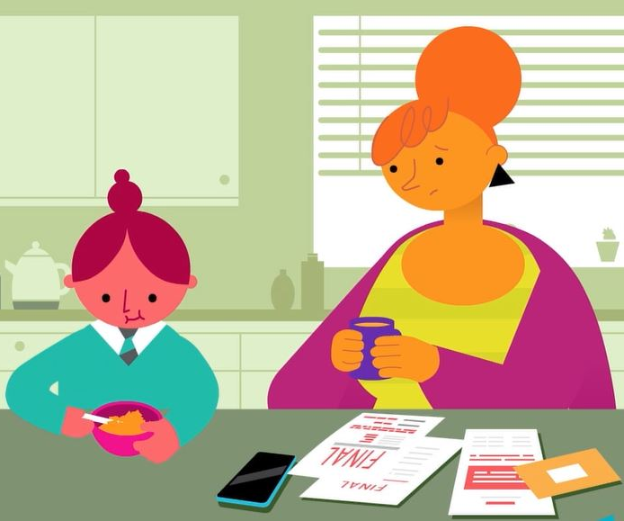
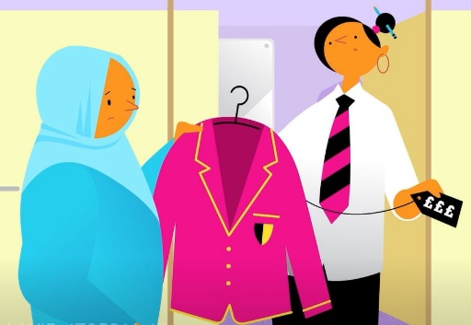
Why is it important to talk about costs and money?
"I was uncomfortable asking for help."
"It’s not easy talking about money problems."
"Guilt, embarrassment, shame."
"It was embarrassing to admit that I was struggling!"
"It's just degrading."
"I felt ashamed that I couldn’t provide for my kids."
"Felt judged."
"Embarrassed as an affluent school and area."
"I was worried my child would find out and that people would make fun of them."
"It's the way they talk to you, you don't feel embarrassed or small." ​
"The headteacher is really approachable and makes it seem normal and okay." ​
"Made me feel at ease for asking and sorted out my problem for me." ​
"I have applied for the new Scottish Child Payment recently due to information I received through school emails."
"I feel less embarrassed about financial worries. I am so grateful for this simple but powerful thing: I feel we are not alone."

Slide 13
Advice from parents and carers
Create poverty aware school communities
Show leadership and take action
Communicate about costs and money
Offer confidential and supportive conversations
“Never heard anything about financial support for parents. My guess is that they assume we don't need it. Which is the wrong assumption.” (Parent)
Talking about costs and money at school - advice from parents and carers | CPAG

Slide 14
Cost of the School Day policies/statements

Slide 15
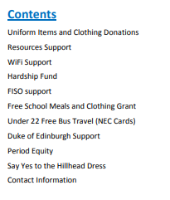
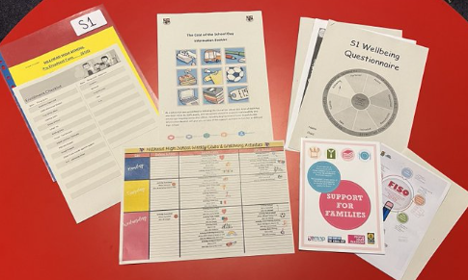
Universal communication – avoiding assumptions
"The main purpose is to bring all of the supports available together, in the one place, to make it easier for everyone. It's an opportunity to support families from the very start." (Hillhead High School)

Slide 16
Referral pathways to welfare rights services
"Providing pathways to money and welfare rights advice from education settings can help prevent child poverty or mitigate its effects, and from a setting that most families with children engage with.”
Public Health Scotland
Financial gain for families
Increased take up of educational entitlements
Reduced burden on schools
Referral pathways to money advice in education settings - briefing | CPAG

Slide 17
Cost of the School Day Voice Network ​
Network of learner voice groups P5 –S6
Young people leading on poverty awareness, equity and tackling costs at school
Influence poverty and education policy by having say on important issues that affect them and their schools.
Co-produce resources that help other schools and young people
Join the network!

Slide 18
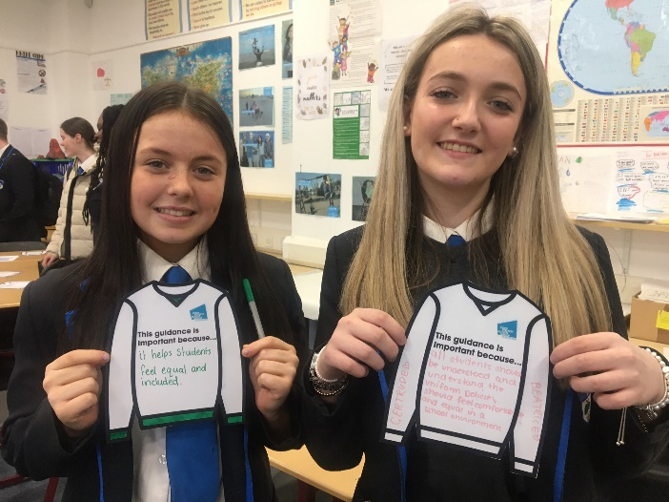
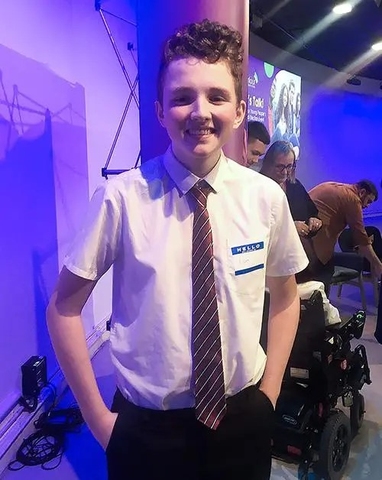
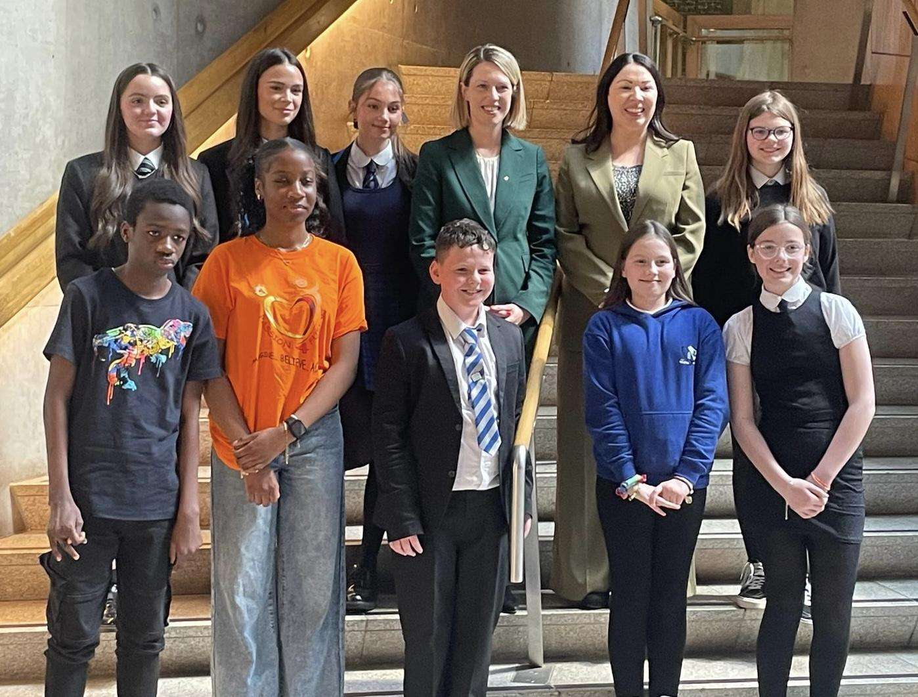
Voice network – national influencing
"I think that free school meals take the financial pressure off of families, so we ask if the government could give more money to schools to help with free school meals for everyone." (S1, North Ayrshire)

Slide 19
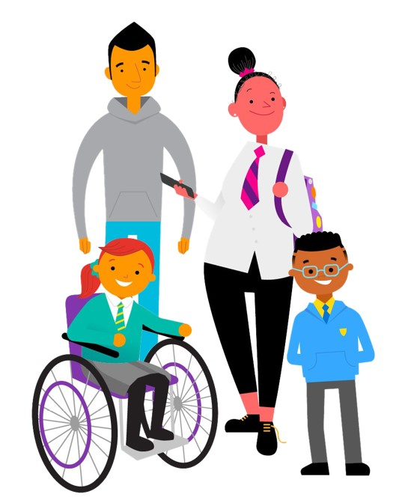
Thank you!
Get in touch with the team: costoftheschoolday@cpagscotland.org.uk
Toolkit, eLearning, Ideas Bank and more:
cpag.org.uk/cost-of-the-school-day

