Slide 1
Legal advice in permanence planning
Kirsty Doull, Permanence Consultant
CELCIS

Slide 2
Discussion Points
What do different local authorities do now – at what point in the process do they get legal advice?
What do we feel is the best time to get legal advice?
What are the challenges in getting legal advice “too early” or “too late”?
How formal/informal are relationships between Social Work and Legal?
Any other comments or questions

Slide 3
Before or after permanence recommendation?
Most of the PACE areas get legal advice AFTER permanence recommendation has been made
A small number get advice BEFORE permanence recommendation
A small number feel they can get legal advice “at any time”

Slide 4
Process Map – Most Common
LAC Review that makes a recommendation for permanence
Legal Advice:
Permanence Planning Meeting (PPM) or Legal Advice Meeting (LAM)
Ratifying LAC Review

Slide 5
What we know about early legal advice
Ensures that Social Work have benefit of legal advice on permanence plan for a child BEFORE asking a LAC Review to endorse that recommendation
Negates the need for further assessment/further exploration (i.e. kinship carers) further down the process when discussions with family about permanence away from home have already begun
Ensures all options may be ruled out – with evidence – at an earlier stage = more robust case for court
Well evidenced plans = getting to court quicker

Slide 6
Referral Form Test of Change
Legal advice before LAC Review that makes a permanence recommendation (Substantive LAC Review)
36% of LAC Reviews were being cancelled due to legal advice not being available before the Sub LAC Review
Reason in most cases: Legal did not have enough time to look at reports from Social Work and give advice
Test of change: Referral Form that asked some key questions to focus on the specifics of what advice is required and a checklist of necessary reports

Slide 7
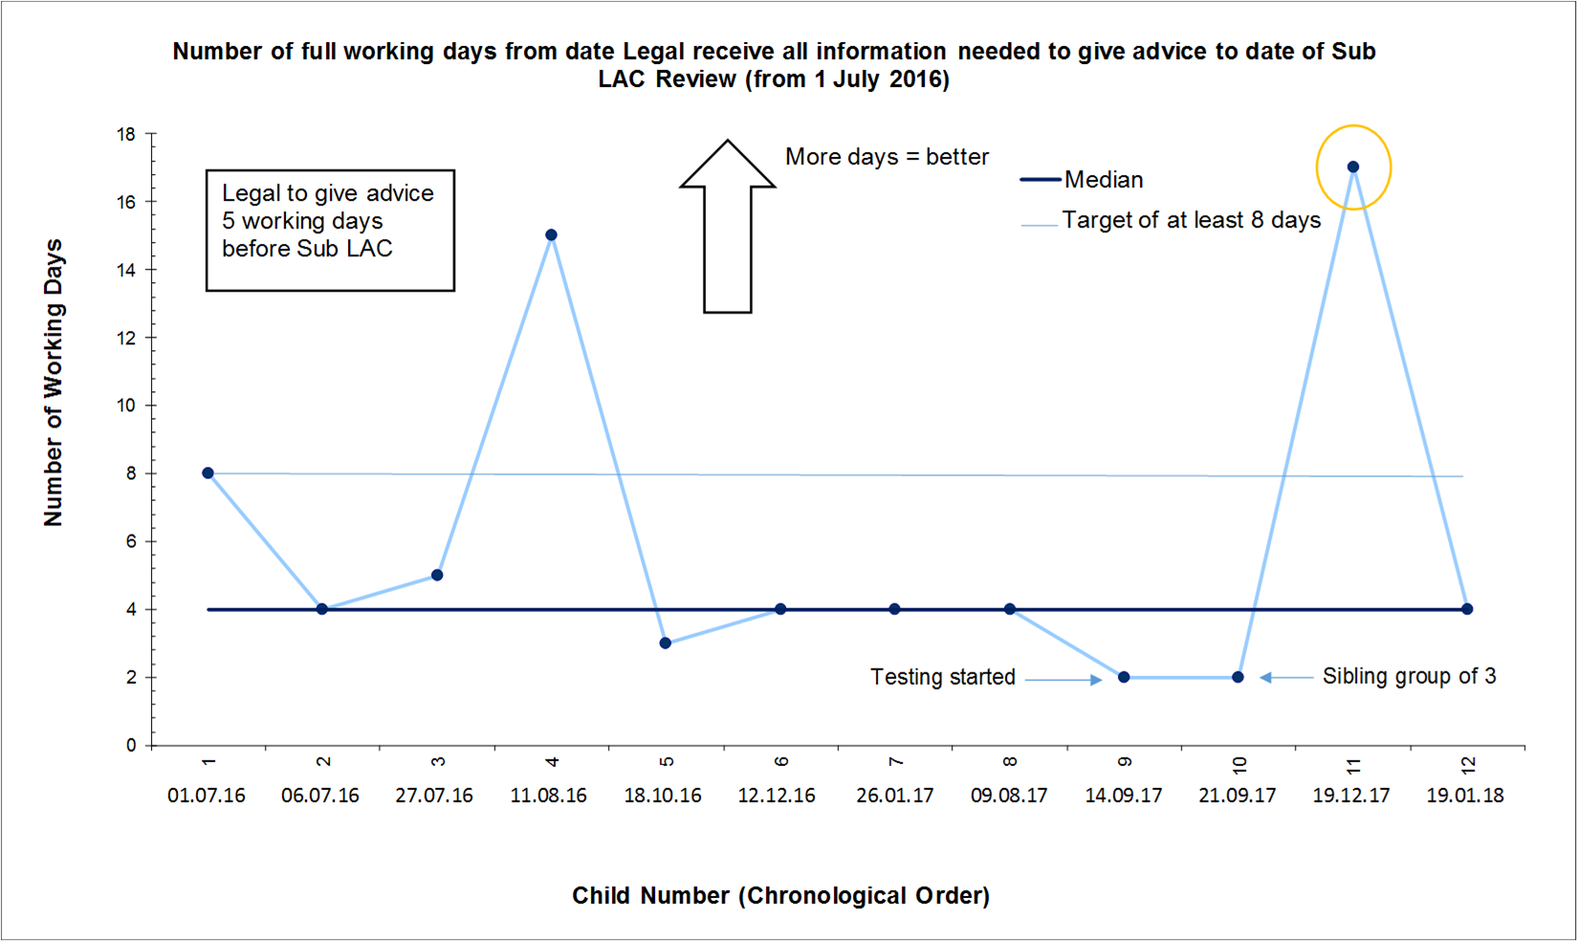
Results so far

Slide 8
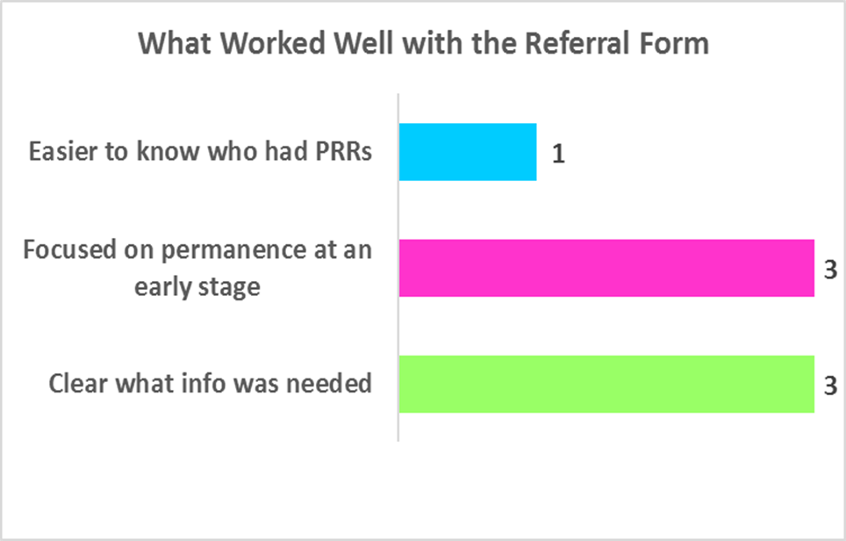
Results so far

Slide 9
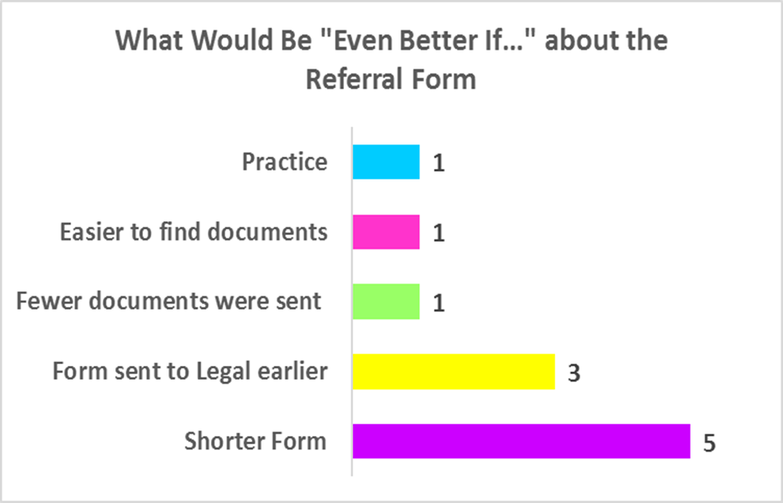
Results so far

Slide 10
Discussion Points
What do different local authorities do now – at what point in the process do they get legal advice?
What do we feel is the best time to get legal advice?
What are the challenges in getting legal advice “too early” or “too late”?
How formal/informal are relationships between Social Work and Legal?
Any other comments or questions

